Slide 1

All business. No trip.

Slide 2

Self-Service Profile Synchronization
Nov 2, 2017

Slide 3
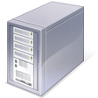
What is Offline Profile Synchronization?
GDS Profile Synchronization allows profile data housed within DEEM to be written to either a Travel Agency GDS or Profile Management System, allowing an agency to fulfill offline bookings for the end-user
“Web Services” (subscription) enables communication between systems
ETSI is our 3rd party Profile Synch Vendor facilitating transmission to the GDS
Due to multiple touch points, synchronization is not instantaneous
Profile Synch Vendor (ETSI)
Customer
Profile
Database
Web Services
(subscription)

Slide 4
Steps for self-service profile synchronization
Super domain configurations
  Assign domain to super domain web service subscription
Domain level configuration
  Create group of users (Profile Synch group) and assign web service subscription
The Profile Synch Interface - ETSI
  Creating and Configuring the Profile Map
Troubleshooting and Logs review
  Test profile synch and troubleshoot as needed
  Review synch logs on a regular basis

Slide 5
Super Domain Configurations

Slide 6
Super domain web service subscriptions
Domain/Site must be assigned to a super domain web service subscription.
    This subscription translates to web service credentials, which allows ETSI to pull profile data across web services
Super domain web service capacity limitation, for load balancing purposes:
    50 Domains to each super domain web service subscription.
    Contact Profile Support when approaching 50 domains
    Submit request via Customer Support Portal asking for a new super domain web service subscription.

Slide 7
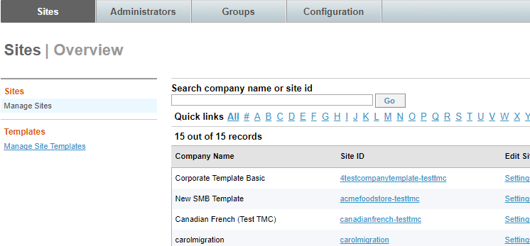
Domain Groups
Web service subscription(s) on Partner Dashboard is applied to a domain group.
Domain Group must contain domain/site for profile synchronization.
Click on the Groups tab to assign a domain to a domain group.

Slide 8
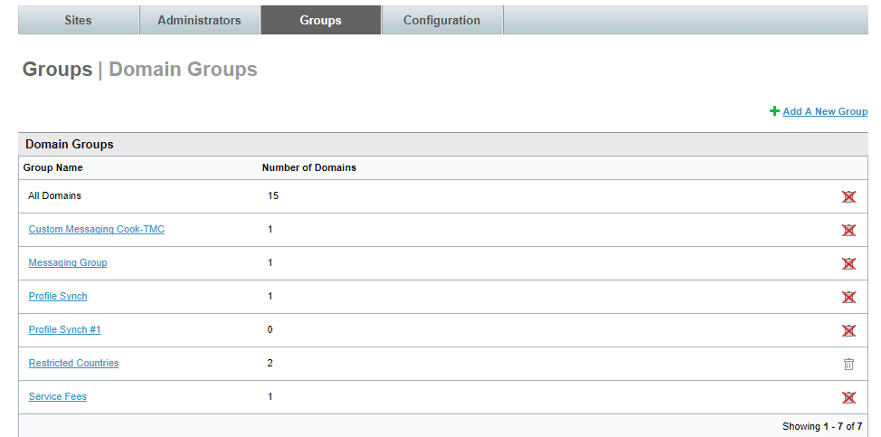
Domain Groups
To add a domain to a domain group, click on the domain group
Only 50 domains per domain group

Slide 9
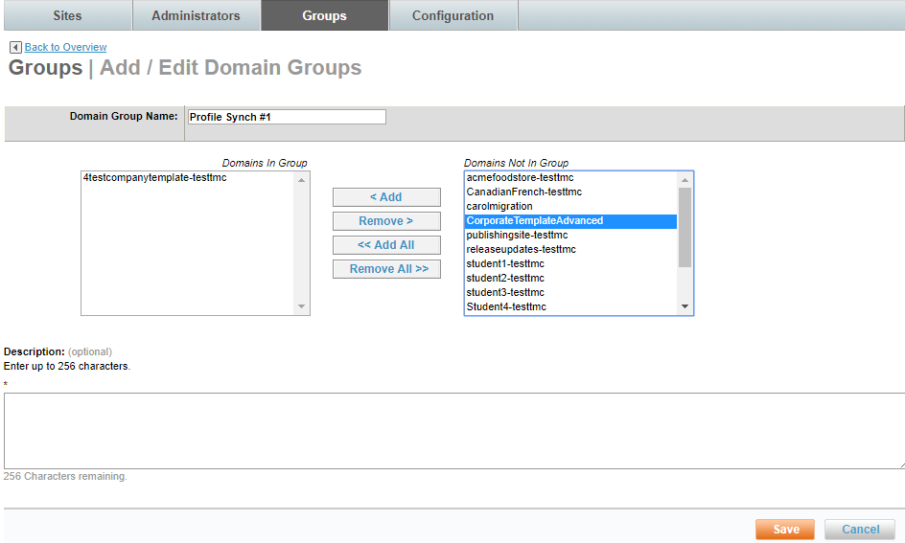
Domain Groups
Highlight a domain(s) in the “Domains Not In Group” column.
Click on “Add” to add them to a group.
Click “Save” once finished.
Don’t forget to commit your changes.

Slide 10
Domain Level Configurations

Slide 11
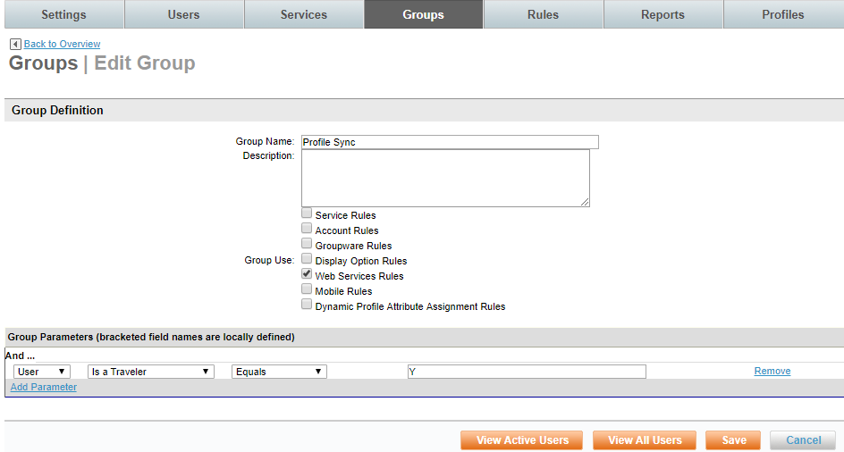
Creating a Profile Synch group within individual domain
Groups ensures that only users meeting set parameters are synched to the GDS
From the Domain Console, drill down to Groups, then Add a New Group
Type in “Profile Synch” for the group name
Select “Web Services Rules”
Group parameters should reflect the appropriate filtering mechanism

Slide 12
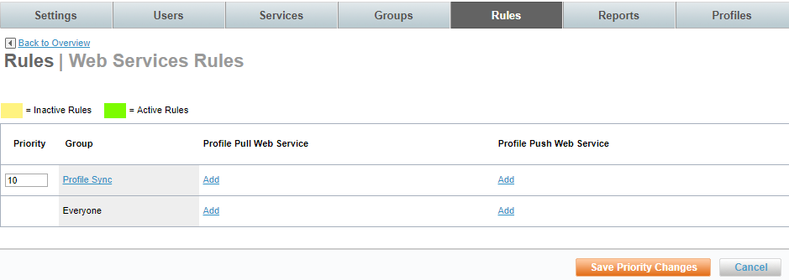
Assign web service subscription to group
Click on “Rules” tab, then “Web Service Rules
Under “Profile Pull Web Service” for the Profile Synch group, click on “Add”
This allows you to assign the web service subscription to the group
Note: If multiple maps for same customer are necessary:
    File a case via the Customer Support Portal to Profile Support
    DEEM will assist with the setup of multiple web service subscriptions, however the maps will still be processed by Site Administrator

Slide 13
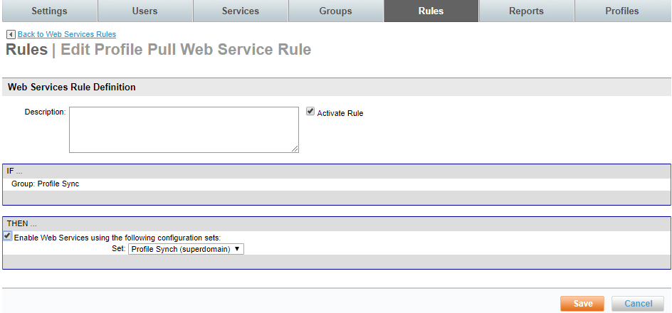
Assign web service subscription to group – cont.
Be sure to activate the rule
Check to Enable Web Services
Select the Super Domain Web Service Set
    You will see “(superdomain)” within the subscription set
    If no set is present to enable, domain is not included in a Super Domain Group

Slide 14
The Profile Synch Interface - ETSI

Slide 15
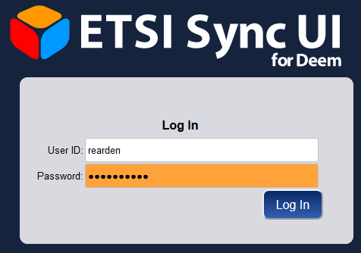
How do I access?
https://www.etravelsystems.com/DeemUI/
Please be sure to save this URL as a bookmark
Your login credentials will be sent to you via e-mail

Slide 16
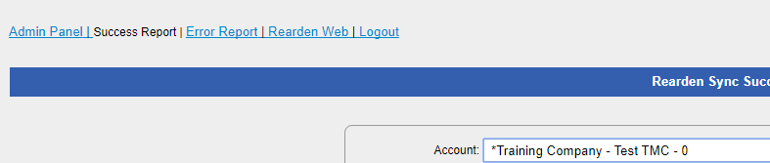
Profile synch interface menu options
Success Report – Provides real-time access to successful synched profiles
Error Report – Provides real-time access to profile synchronization errors
Rearden Web – Interface to create/edit profile synchronization maps

Slide 17
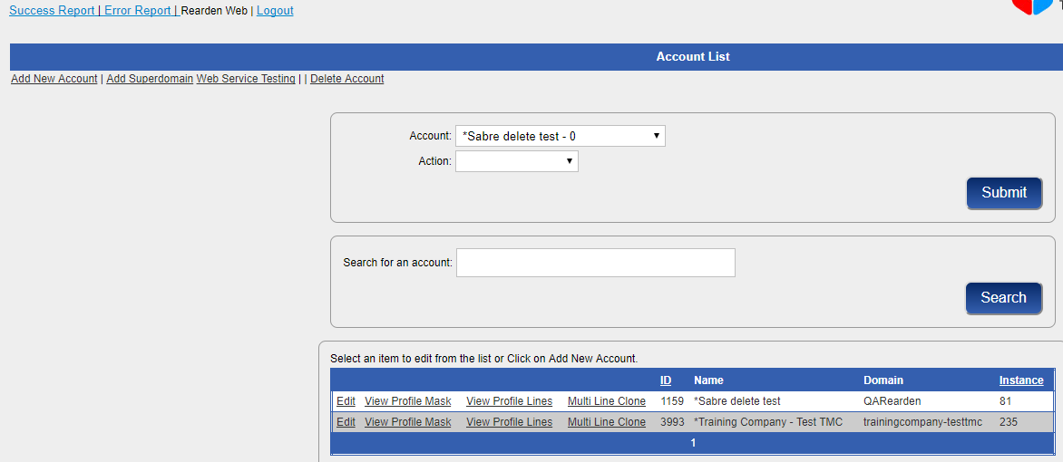
Profile synch configuration interface
Edit: Allows you to change domain name, GDS, profile naming, etc.
View Profile Mask: Allows you to change PCC, 1st level profile.
View Profile Lines: Allows you to add, change, or remove profile lines.
Multi Line Clone: Allows you to clone multiple lines to an account
      Add New Account: Allows you to create a new account

Slide 18
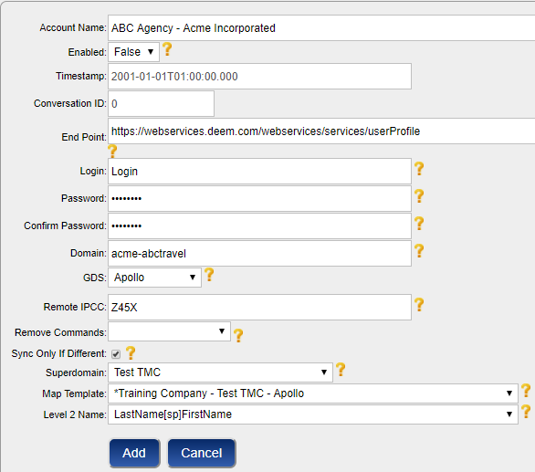
Adding a new profile map (Add New Account)
Account Name: follow standard “Agency - <Company Name>”. (i.e. ABC Agency – Acme Incorporated).
  If multiple maps for the same customer, include group name (Agency – Customer – Group)
Enabled: Set this to “True” once configuration is complete
End Point: Leave current default
Login/Password: Enter “password” in password and confirm password fields
Domain: Enter DEEM domain name (i.e. acme-abctravel)
GDS: Select the appropriate GDS

Slide 19
Adding a new profile map – cont.
Remote iPCC: Should match the PCC on the “Profile Mask” page.
Remove Commands: Select agency
  Only for SABRE Accounts
Sync Only if Different: When set, profiles will only synch to the GDS if data has changed since the last time the profile was synched to the GDS.
Superdomain: Select superdomain web service subscription assigned to the account.
Map Template: Select map to copy
Level 2 Name: Select profile naming convention

Slide 20
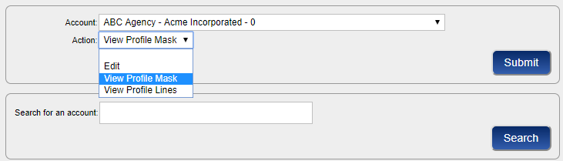
Adding a new profile map – cont.
Once new account has been created, retrieve the newly created account to complete initial setup:
Select account from the dropdown, and select View Profile Mask
or
Search for the account name, and click Search.
Once found, click on View Mask

Slide 21
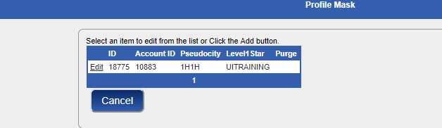
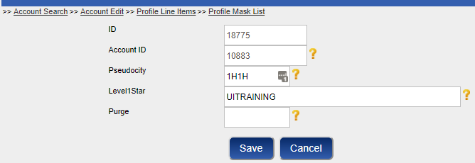
Adding a new profile map – cont.
Click Edit to update the PCC and 1st level STAR/BAR where profiles are to be synched
Enter the PCC in the Pseudocity field.
Enter the 1st level STAR/BAR into the Level1Star field using all capital letters
Do not enter anything into the Purge field.

Slide 22
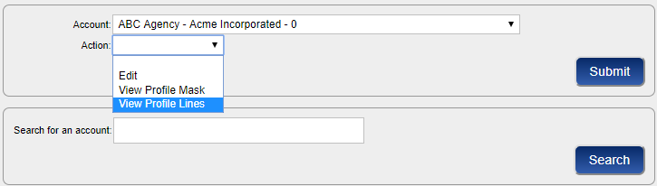
View/Modifying Customer Specific Lines
Specific line formats may need to be modified, added or deleted for newly created accounts or existing accounts.
Select account from the dropdown, and select View Profile Lines
or
Search for the account name, and click Search.
Once found, click on View Profile Lines

Slide 23
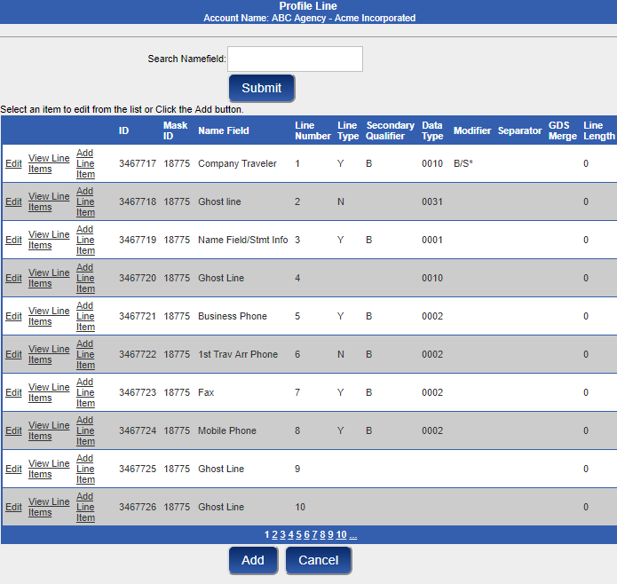
Modifying profile lines
To Edit the line description (Labeled Name Field), number, type (Always move, never move, etc.), secondary qualifier or modifiers, click on Edit.
Each profile line must have Line Items created. Line items drive components of the GDS format, as well as the XML data used to populate the profile line.
Modifiers are used to drive GDS formats for Sabre/Worldspan accounts.
Data Types are used to drive GDS formats for Apollo/Galileo accounts.
Click Add to add new line

Slide 24
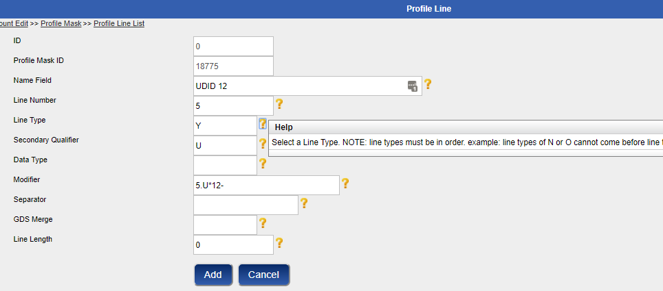
Adding a profile line
Add the line number, the line type, applicable secondary qualifier, and modifier.
Click Question marks to the right of the line for additional help
Once profile line is added, profile line items must be created to add data to profile line.
Note: Apollo maps must have a data type (i.e. @:5), which drives the GDS command, rather than the modifier. Data types will appear as a drop down when applicable.

Slide 25
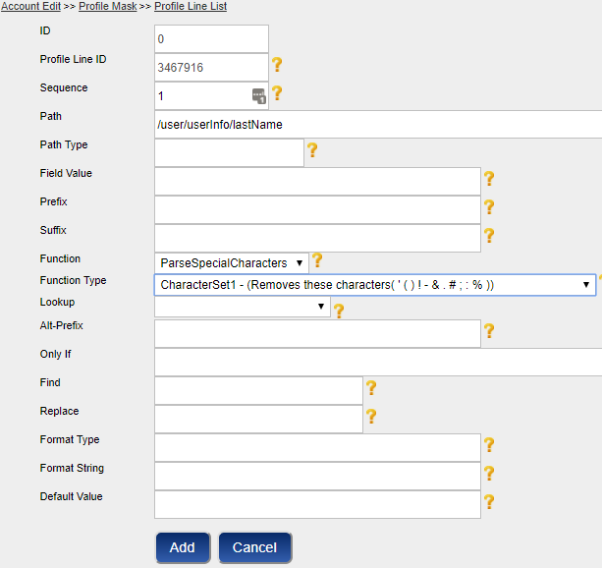
Adding a profile line item
Sequence is the used to determine the order of XML data
Path should contain the XML path for the desired data
Prefix is any hard-coded value preceding data (often used with writing statement information)
Suffix is any hard-coded value following data (often used with Worldspan accounts, applying # at the end of the line)
Function contains any special actions associated with that line
  Every function must have a corresponding Function Type.

Slide 26
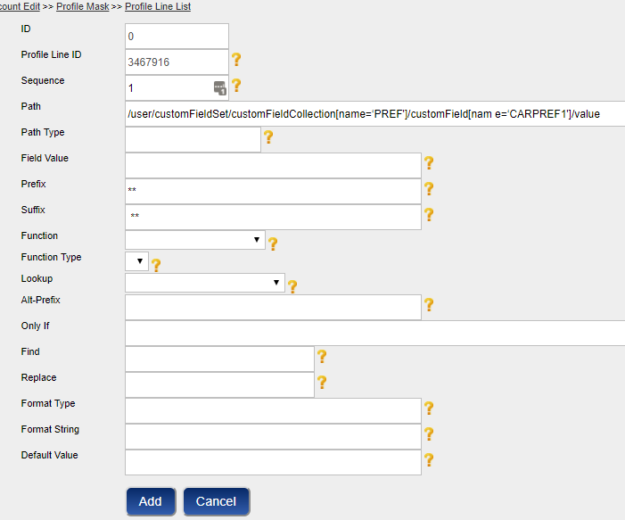
Using custom fields data in line items
Using custom fields in the path requires the custom field collection and custom field name
/user/customFieldSet/customFieldCollection[name=‘PREF']/customField[name=‘CARPREF1']/value

Slide 27
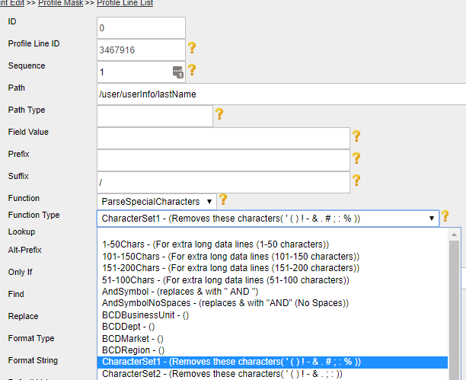
Using Functions in line items
Functions allow you to apply custom coding to each profile line item
  Removing special characters
  Specify an explicit date format
First select the function from the drop down list, then the corresponding type

Slide 28
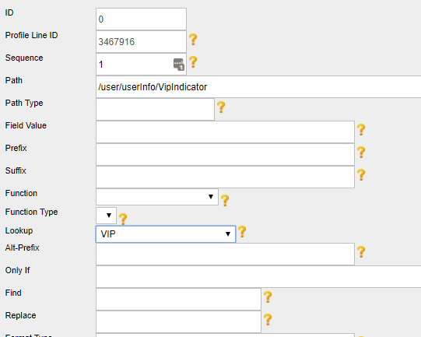
Using Lookup in line items
Lookups allow you to perform value substitutions
  If VIP = “True”, then write “*** VIP ***”
Select the appropriate lookup value

Slide 29
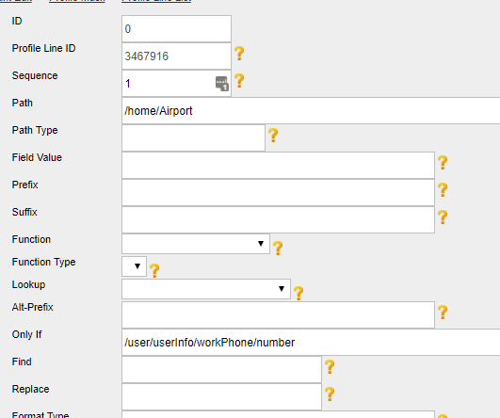
Using Only If Statements in line items
“Only If” statements are used to add conditionals to the profile line item.
Sample – Only write the profile line item for home airport if there is a value in the phone field.
  /user/userInfo/workPhone/number would go into the Only If field.

Slide 30
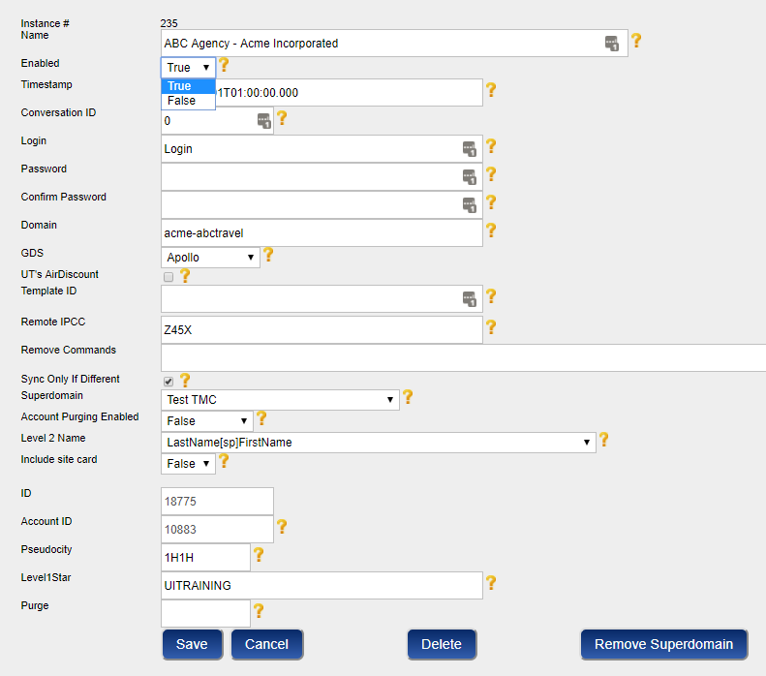
Finished?
Once you have completed the mask, and updated all necessary profile lines, you must enable the account.
This is completed from the “Edit” page of the account (Select “Edit” in the “Action” drop-down, or click on the account name in an account search.

Slide 31
Tips to remember
Any XML fields that contain underscores need to be wrapped in brackets.
  /user/servicePreferences/airlinePreferences/membershipSet/membership_1/airlineCode
Is translated to the following:
  /user/servicePreferences/airlinePreferences/membershipSet/membership[1]/airlineCode
Use the prefix and suffix fields to link data with hard-coded GDS formats.
Ensure your “Path” in each profile line item is cased properly
  Improper casing will cause data to not populate to GDS

Slide 32
Troubleshooting and Logs Review

Slide 33
Troubleshooting
If your newly created account is not synching to the GDS, check the following:
Ensure the web service is correctly established.
  Domain is assigned to proper domain group.
  Changes have been committed at super domain level
  Web service rule enabled to the proper group at domain level
  Ensure that users meet group parameters (i.e. using home phone for group, that users contain home phone)
  Changes have been committed at domain level
  Web service assigned to profile mask in configuration UI
Ensure that the mask is enabled.
  On the “Edit” page of the mask, the “Enabled” toggle should be set to “True”.
Check for domain name consistency
  Domain name in UI must match domain shortname in Services Console.
Check for 1st level star consistency
  1st level star must match 1st level profile listed in configuration UI
Branch access
  Ensure that branch access has been opened between your Sabre Web Services iPCC and PCC housing profiles for Sabre or between 1H1H and PCC for Apollo

Slide 34
Online Synchronization Logs
Once the profile map has been processed for a particular customer, real-time access to the following information is available online:
  All user profiles that were successfully written to the GDS.
  All user profiles that were not successfully written to the GDS.
    Error response included with every user.
Access the online synchronization log from the ETSI interface menu:

Slide 35
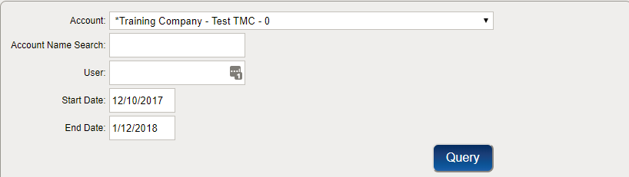
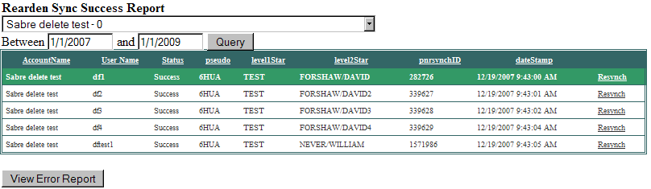

Online Synchronization Log Success Page
Use drop down list to select account (Only accounts owned by agency is displayed)
  Number immediately following account name refers to the number of profiles “In queue”, or waiting to be synched
Use the date fields to narrow search down to specific dates profiles have synched.
  For instance, if you wish to view profiles that have synched today, you would simply change the first date to today’s date, and click on “Query”
Click on “View Error Report” to view any synchronization errors associated to this account.

Slide 36
Success Page Continued
Account Name: Name of account each customer is filed under - Standard naming convention is <Agency> - <Customer Name>
Username: All synch processes utilize username as unique identifier
Status: Advises whether the synch process was a success, or failure (Often times referred to as System.Exception)
Pseudo: GDS PCC assigned to account Database.
Level1Star: First level star profile is being written to
Level2Star: User profile name assigned to each user.
PNRSynchID: Data field utilized for PNR Synchronization
Datestamp: This is the timestamp (MST) assigned when the user profile has synched to the GDS.
Resynch: Allows you to resynch a profile to the GDS ( based on data already housed in ETSI vs. refreshing DEEM profile)

Slide 37
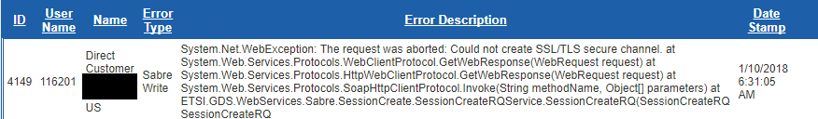
Sample Error Responses in Error Logs
Most errors are GDS Centric (i.e. VERIFY MILEAGE MEMBERSHIP NUMBER)
Verify Exceeds Maximum Length
  Data passed through to GDS exceeds GDS Limitations.
No Star Level One – One of three possible scenarios:
  First level star has not been created.
  First level star submitted on profile map does not match first level star in GDS.
  Branch Access is not opened.
Verify Mileage Membership Number – One of three possible scenarios:
  Improperly formatted mileage plus number.
  In case of Apollo, Apollo validates UA frequent flyer numbers for proper length.
  In case of Sabre, Sabre validates AA frequent flyer numbers for name association.

Slide 38
Sample Error Responses in Error Logs Continued
Invalid Zip Code
  Address/Delivery fields are validated for format/length in GDS.
  Most common occurrence is invalid formatting of “5+4” zip codes.
Verify Subfield – One of three possible scenarios:
  Address field is mapped to contain Company Name, and data is not present.
  Street address is not present, however mailstop/suite, city, state and zip are passed.
  Invalid GDS characters in address, mailstop, city or state fields.
Verify Name Field Format
  Presence of non-alpha characters in name field.
    Special characters are stripped automatically.
    This error is most commonly found with presence of numeric characters.
NG – NOT IN SA MODE U/C
  Web service connection issue, and is typically self-resolving.
  Attempt to re-synch profile, and if problem persists, file case to Profile Support.
Additional errors that require assistance from Profile Support:
  ITEM NRA?
  Unable to Process
  Configuration Error (Listed under error type)

Slide 39
Resynching errors in bulk
Click on “Error Report”
Drill down to account you wish to resynch
Click on “Resynch All Errors from Account”
All users listed in the error report will attempt to resynch.

Slide 40
Questions?
Any questions regarding the synchronization process, which includes map processing, or error handling, should be routed to Profile Support.
  Log into the Customer Support Portal
  Open case with query.
  If a question about a specific error(s), include the following information:
    Domain
    Username(s)
    Copy/Paste error response into case.

Slide 41

Thank you.

