Slide 1
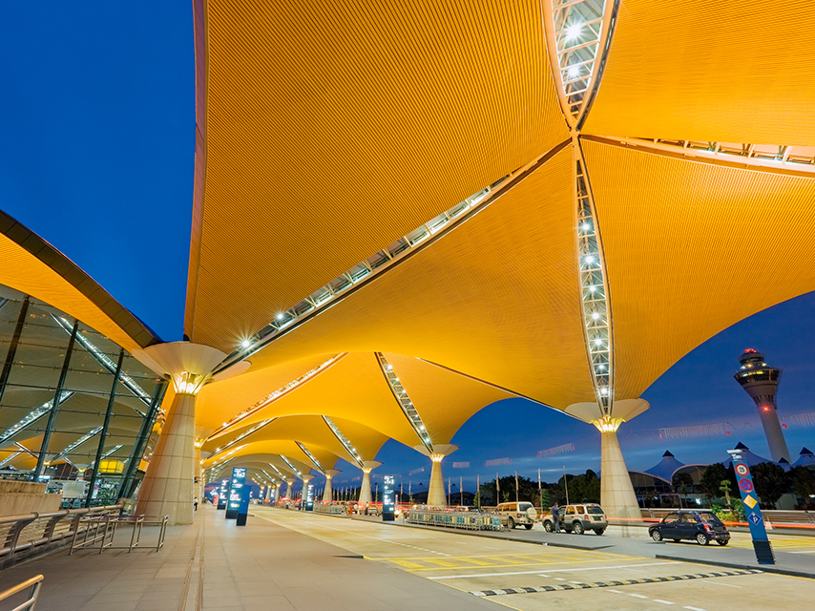
Dynamic Site Messaging
Training
Jan 31st, 2017

Slide 2
Topics for Today
What is Dynamic site Messaging (DSM)?
How to configure DSM DSM Mobile Push Notifications

Slide 3
What is DSM?

Slide 4
Defining DSM
Dynamic Site Messaging (DSM) is a process where a company or agency administrator
can create custom messages that display to the traveler on the Deem Travel platform.
The purpose of these messages are to communicate certain travel policy or supplier
related information directly to the traveler during the booking process. They are dynamic in a sense, that they would only be displayed when certain criteria / components of the search form or supplier display/selections are met. The company/agency administrator can create these messages based on (but not limited to) certain date ranges, departure or arrival cities, suppliers, car types, airline classes of service etc.
If enabled, the traveler will see the Dynamic Site Messaging on the Home, Search
results, Review, Purchase, Trip Confirmation, Trip details, and the Trip planner pages.
You can also set up Dynamic Site Messaging to display in Trip Confirmation, Hold Trip,
Modify Trip and Cancel Trip emails.

Slide 5
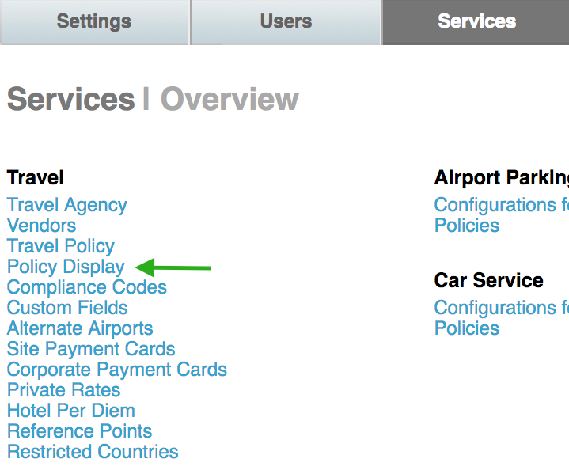
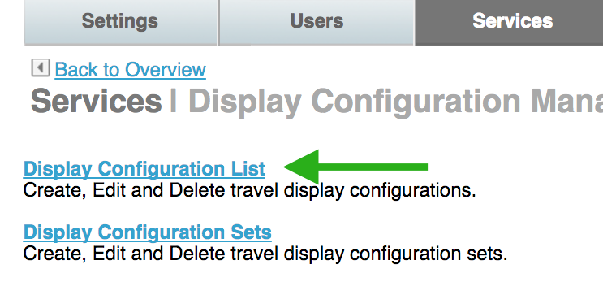
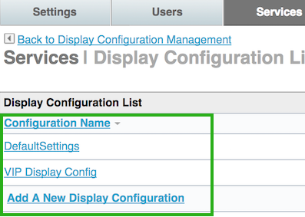
Enabling DSM
From the Partner Dashboard, click the Services tab and click the > Policy Display link
Click the Display Configuration List link
Click on the configuration name you want to have DSM enabled
Scroll to the Dynamic Site Messaging section of the page and click the “Yes” radio button to enable DSM.
1
2
3
4

Slide 6
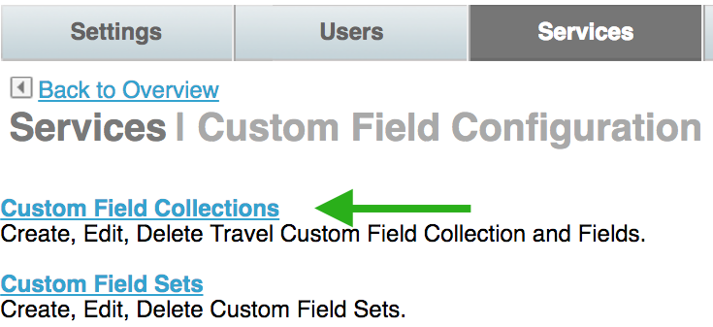
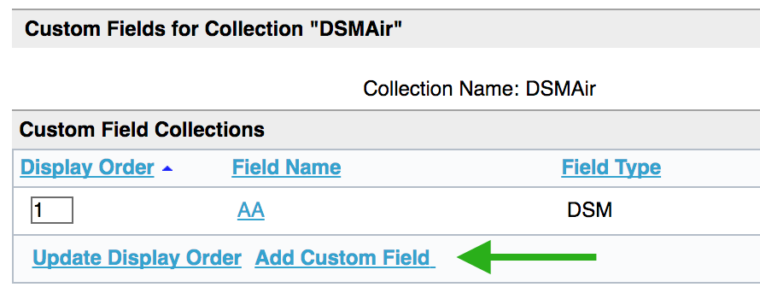
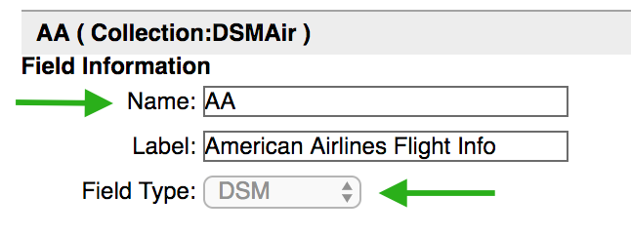
Configuring DSM
5. Click the Services tab and click the Custom Fields link
6. Click the Custom Field Collections link
Click the Add a New Collection link
Enter the Collection Name in the Name field
9. Click Save
10. Click the collection name link
11. Click the Add a Custom Field link
12. Enter the Name of the Field
13. Select DSM from the Field Type drop down list
6
7
8
11
12
13

Slide 7
Message Settings
Configuring DSM
Message to user
(html tags or plain text)
Lightbox
Message to user (on mobile)
Text only
Supports up to 250 characters
Inline message display
Trip type
Date range

Slide 8
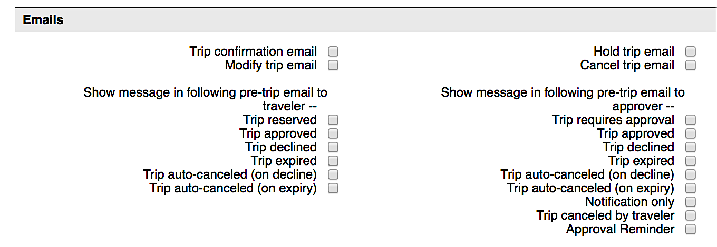
Where to display DSM
Select the check boxes where you want the DSM to display
Best Practice:
Trip Search & Home Page
General messaging
Review and Purchase Page
Conditional messaging
Select which emails (if any)

Slide 9
Configuration
Click the Advanced link to add any conditionals
Enter the script
Wiki
Click Save

Slide 10
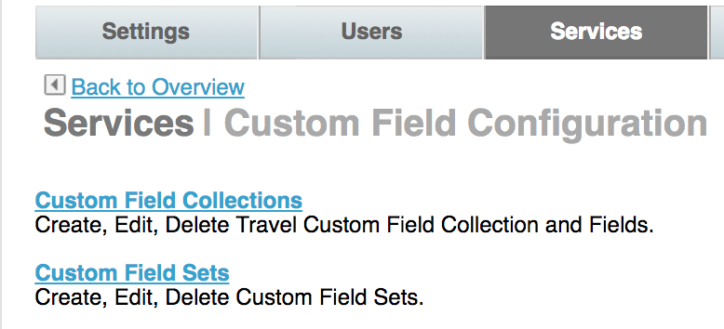
Configuration
Sequence the fields in the order of importance
Add the collection to the set and the set to the user’s rule, if not already there
Commit changes

Slide 11
Dynamic Site Messaging (DSM) – Mobile Push Notifications
Dynamic Site Messaging (DSM) is a process where a company or agency administrator can create, change and delete custom messages for display to the traveler on the Deem Travel platform.
DSM Functionality Now has Mobile Push Notifications
Site administrators now have the option to allow the system to send mobile push notifications to travelers via the mobile app
Push notifications can remind travelers about upcoming trips and provide information about compliance and tasks needed to be completed without human intervention.
Example: When a traveler books flights, hotel and rental car, the system registers an expense trip event to send the traveler a push notification 1 day prior to the trip end date. The traveler is reminded to submit their expense report on time.

Slide 12
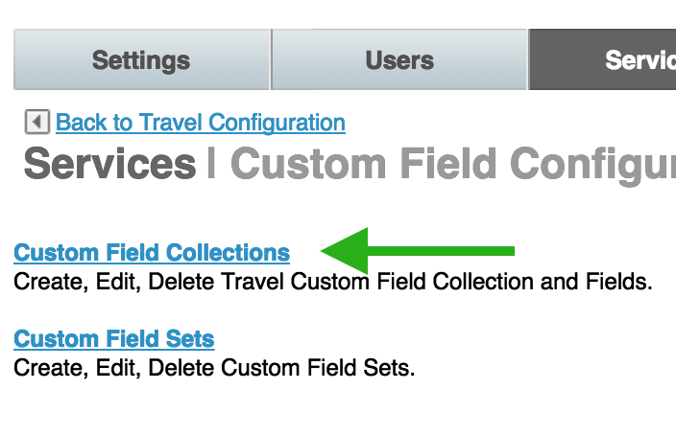
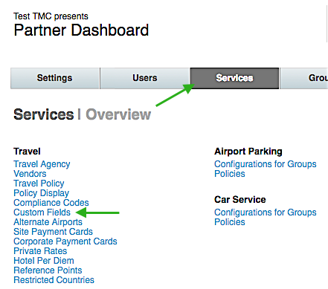
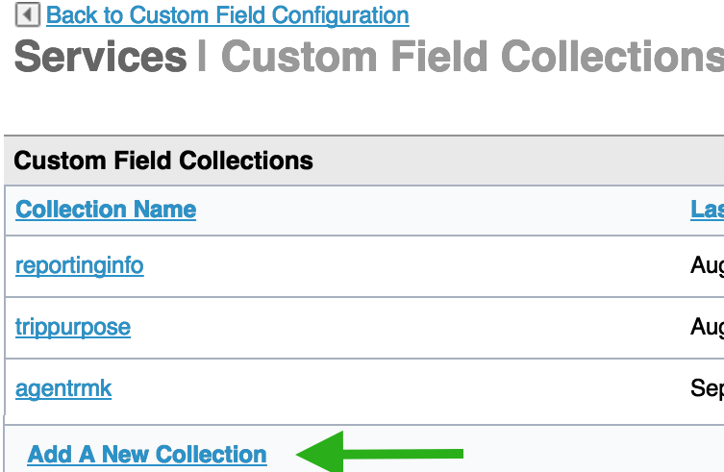
DSM Mobile Push Notifications
How to Configure:
3 - Click the Custom Field Collections link
1 – Click the Services tab
2 – Click the Custom Fields link
4- Click the Add A New Collection link

Slide 13
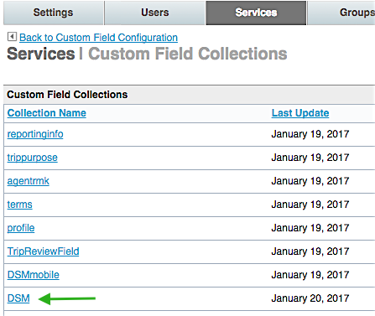
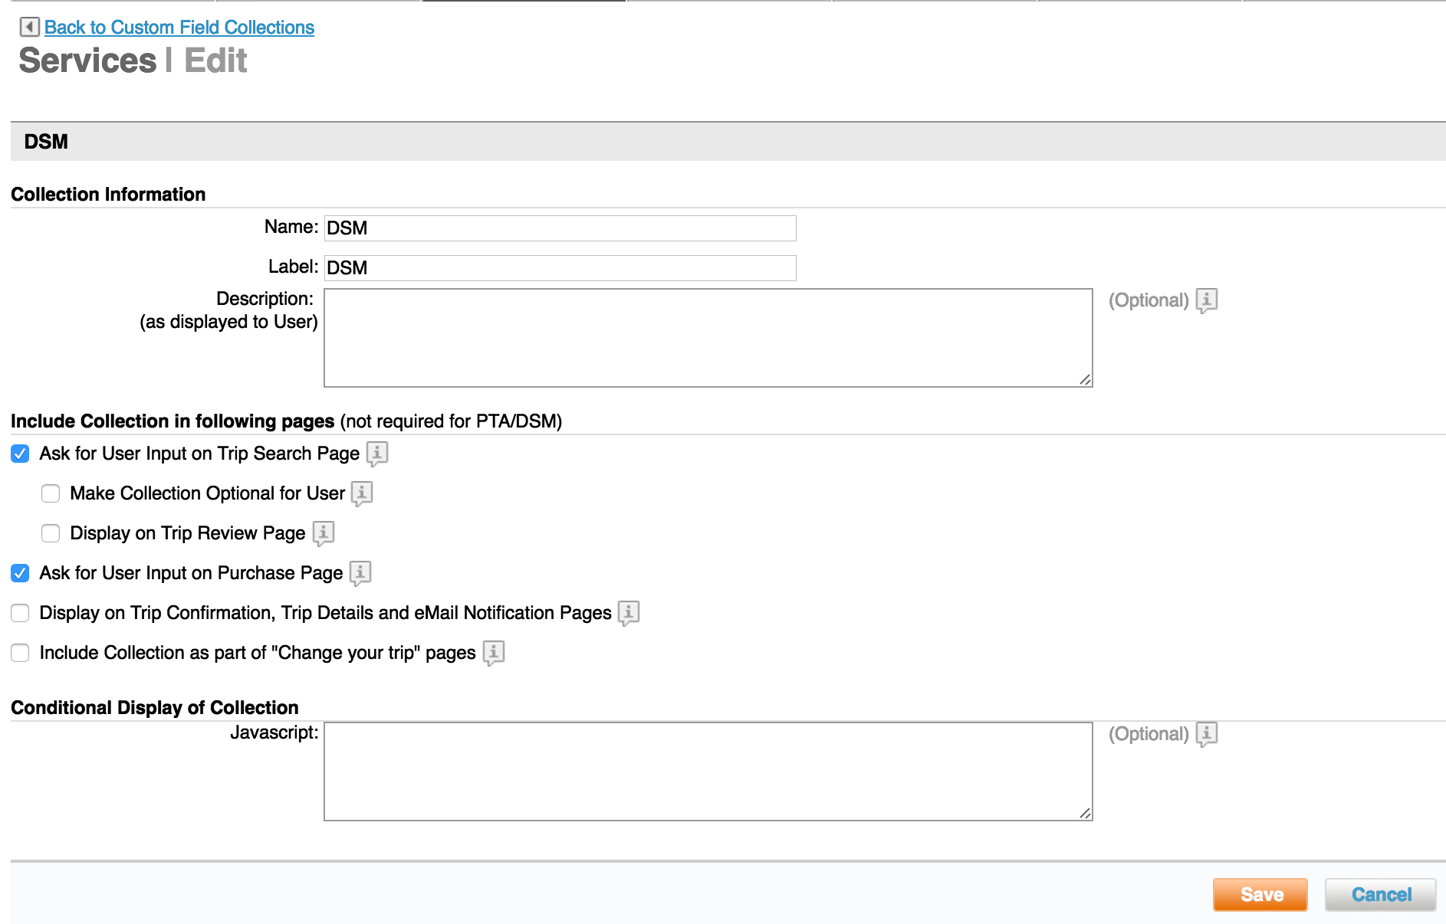
DSM Push Notifications
4 - Enter Collection Name
6 – Click the DSM collection link
5 - Click Save
7- Click Add a Custom Field

Slide 14
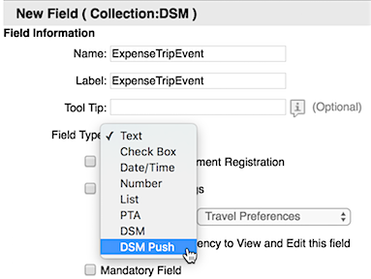
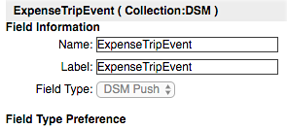
DSM Push Notifications
8 – Enter the name of the new custom field
9 – Click the dropdown arrow in the Field Type section
10 - Select DSM Push from the list
The field type will now display DSM Push

Slide 15
DSM Push Notifications
Scroll down the page to the “Message Push Notification settings section
11 - Enter the message displayed to the user. (plain text or HTML tags)
12 - You can enter a date range during which the rule should be triggered
(Optional)
Notes:
Hyperlink (URL): This is an optional field and will be used in the case when notification needs to direct user to an external URL such as corporate policy or security

Slide 16
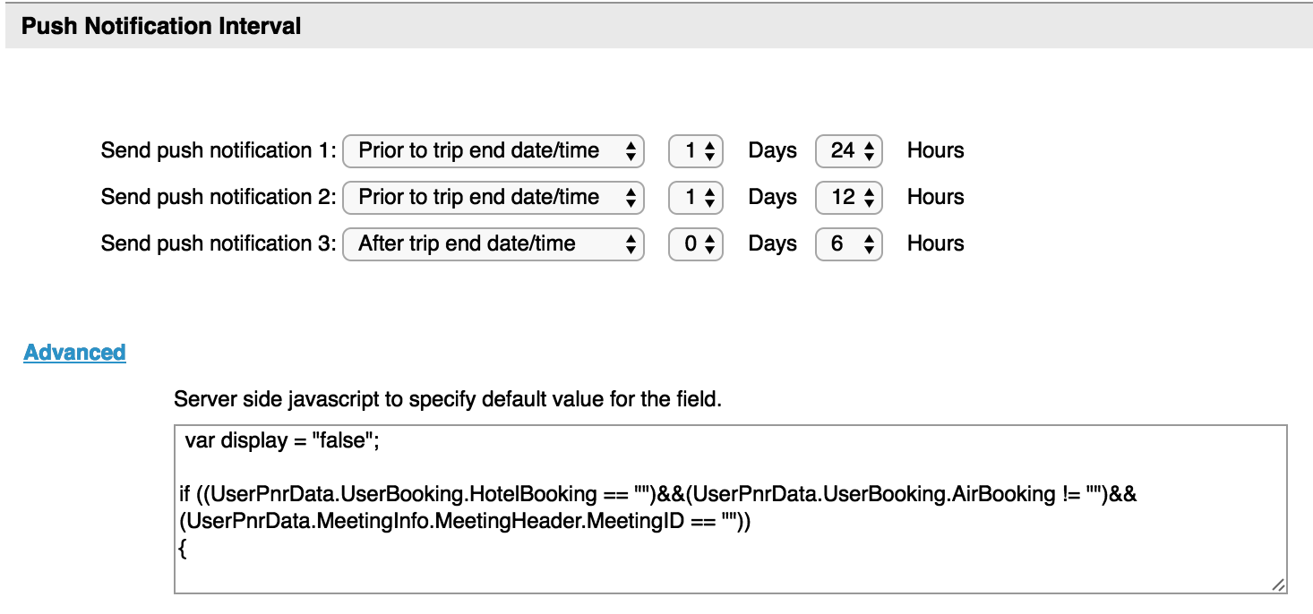
DSM Push Notifications
Scroll down the page to the Push Notification Interval Section
13 – Select the time intervals to send the push notifications:
Prior to trip start date/time Prior to trip end date/time After trip start date/time
After trip end date/time After trip creation date/time
14 - Click the Advanced link
to enter the JavaScript
criteria for this field
Notes:
Sequence the fields in the order of importance.
Add the collection to the set and the set to the group’s rule, if not already there.
Commit changes.

Slide 17
Points to Remember
HTML tags and plain text can be used for messages using up to a 1500 character limit including the HTML tags.
Message display can be conditional – that is, if a condition is true, then the message will be displayed.
The same message can be displayed on multiple pages by selecting multiple check boxes
Sequence the fields within the Collection by importance; the display order is used to determine which message will be displayed
Multiple messages can now be displayed Example: “Pre-trip Approval is required for this trip / There are incentives if you travel in coach class.”
Intranet and internet links can be included in a message
A picture can be displayed if it is stored on a server and a link to it is provided
There is no charge for you to enable DSM
A library of scripts is available at Dynamic Site Messaging Use Cases and Scripts

