Slide 2
Cost Allocation Review

Slide 3
Cost Allocation VS Custom Fields
Cost Allocation allows for a TMC/Customer to either manually "upload" a file or set up an "Automated Feed". Custom Fields do not allow for either.
Cost Allocation configuration is 'limited' to only appear on the "purchase page". Custom Fields may be displayed throughout the booking process.
Cost Allocation and Custom Fields are both available on desktop or mobile.
Cost Allocation Max file size is: 30MB. Custom Fields Max Character limitation is: Configuration (list type) option labels and values field to allow the admin to enter up to 4000 characters only
Cost Allocation feeds can be automated for a one time set up fee. SOW required.
Cost Allocation feature needs to be enabled/requested via a support ticket. No SOW required to enable.
Cost Allocation feature allows for nesting. Custom Fields do not offer nesting. Nesting allows the user to choose a "Parent Value" and in turn presents the option for the "Child Value" nested under the "Parent".
Cost Allocation and Custom field data can be written to PNR scripts per the specs of the TMC/Customer.

Slide 4
Protocol for TMC to request Cost Allocation
File a Support Ticket
Support forwards ticket to Travel Configuration Team.
If Automation is requested, Configuration Manager sends request to Sales so they can reach out to TMC/Customer to complete SOW.
Once signed, Sales sends back to Configuration Manager so they can attach to SFTP request.
If Automation is not requested, Deem Support will request to have the feature enabled on the requested site.

Slide 5
Field Configuration Information:
Searchable Fields:
1. Allocation Name
2. Allocation Code
Search Results Displayed Fields:
1. Allocation Name
2. Allocation Description (only for the child in the case of nested segments)
Template/Upload Fields: All headers must be present whether in use or note (specifically for 5-7)
1. Allocation Name – Required - maximum character length of 45 characters.
2. Allocation Description – Required - maximum length of 180 characters.
3. Allocation Code – Required if you want to capture a numeric value or string - maximum length of 35 characters.
4. Parent Allocation Name – Required if Nesting one Allocation to another - Optional field unless you are using Nested field
5. Expense Approver ID - Not applicable for Travel 6. Expense Approval Threshold Amount - Not applicable for Travel 7. Travel Approval External ID – Not Required
Nested Fields:
1. In the case of a nested segment, the Parent Allocation name must exist/be configured in order for it to upload successfully.

Slide 6
Cost Allocation Template – CSV file only
Validations: These are important when uploading cost allocations.
File Header Validations:
1. File header is empty
2. File header has lesser number of fields than expected
3. File header names validation
Business Validations: Below are the list of business validations failure cases:
1. Ensure ALL columns and headers are included in the file - use the template and ensure the headers are added correctly.
2. Input Segment Name is not present in the system
3. Parent Segment not found in system for the input Parent Allocation name
4. Input Parent Allocation name is not present in the system
5. Linking active child allocation to inactive parent allocation
6. Parent allocation's segment is not the parent of the segment that owns the child allocation
7. Duplicate Allocation Names are NOT allowed.

Slide 7
Cost Allocation – Field Limitations and Validations
Special Characters
Below is the list of special characters that are supported in Allocation Name, Allocation Code and Segment Name: ~ ` ! @ # $ % ^ & * ( ) _ - + = { : ; } [ < , . > ] ? / " ' | \
NOTE: Following combination of special characters in allocation names causes issues in rendering the page. <? ">
Maximum File Size and Type
CSV file only file type accepted
Cost Allocation does not impose a 'character limitation per se', however, only allows a maximum file size of 30MB

Slide 8
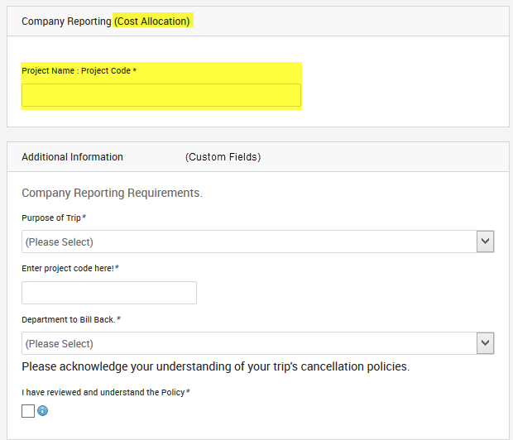
Cost Allocation – Desktop UI
Purchase Page Placement is
directly above Custom Fields.
Type-ahead feature to
accommodate large files and long
lists of data.

Slide 9
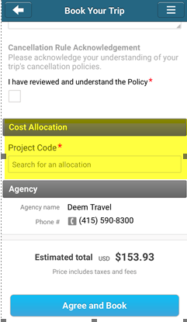
Cost Allocation – Mobile UI
Placement on the Purchase Page on Mobile – displays right after the Custom Fields

Slide 10
Thank You

