Slide 1
Winter 2016 Release Workshop
November 2, 2016

Slide 2
Release Workshop – Winter 2016
Agenda
Dynamic Site Messaging (DSM) now has mobile push notifications
Pending approval tag has been added to our PTA fields
Delta Comfort + Availability and seat selection improvements
Added XML tag in pre/post booking flow for hotel rate changes
Dynamic Site Messaging (DSM) now displays multiple messages
Mobile Pre-Trip notification to traveler
Mobile now supports Travelfusion
Mobile DSM increase character limit

Slide 3
Dynamic Site Messaging (DSM) – Mobile Push Notifications
Dynamic Site Messaging (DSM) is a process where a company or agency administrator can create, change and delete custom messages for display to the traveler on the Deem Travel platform.
DSM Functionality Now has Mobile Push Notifications
Site administrators now have the option to allow the system to send mobile push notifications to travelers via the mobile app
Push notifications can remind travelers about upcoming trips and provide information about compliance and tasks needed to be completed without human intervention.
Example: When a traveler books flights, hotel and rental car, the system registers an expense trip event to send the traveler a push notification 1 day prior to the trip end date. The traveler is reminded to submit their expense report on time.

Slide 4
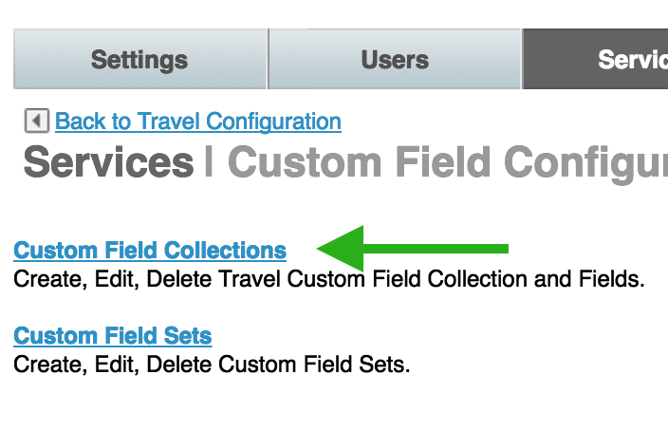
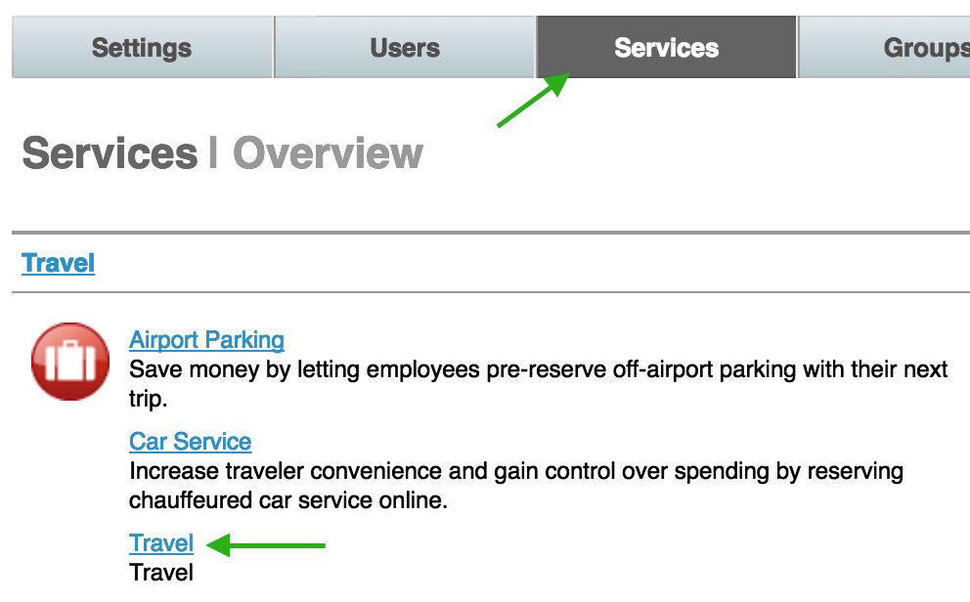
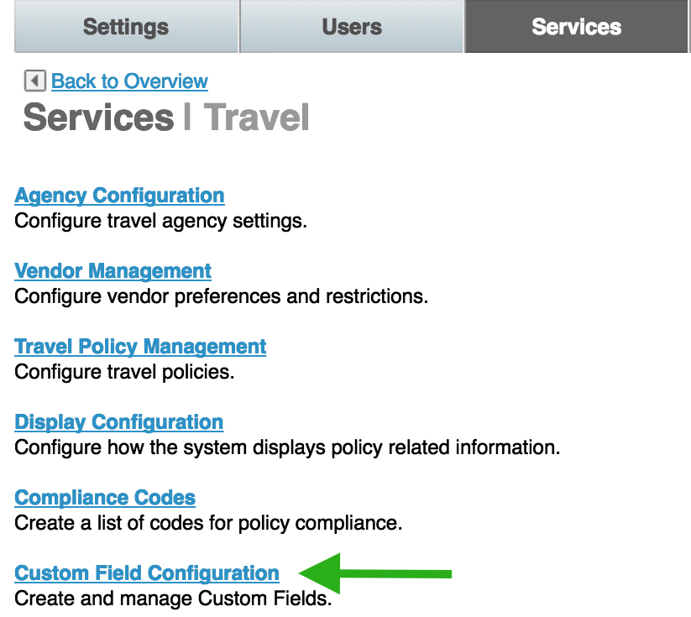
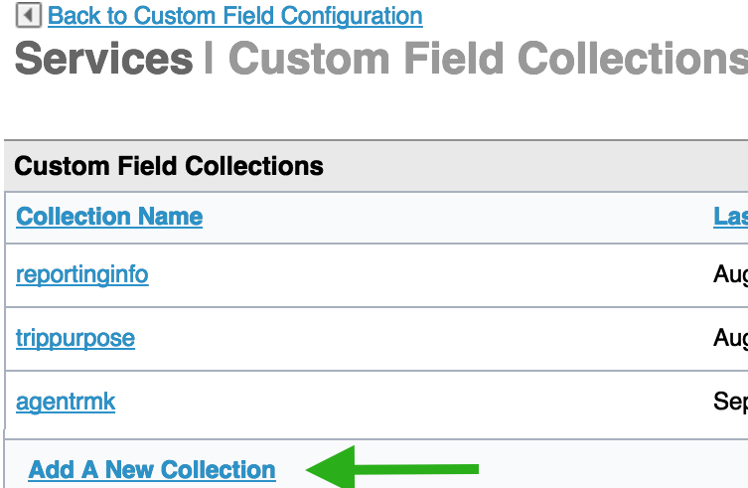
DSM Mobile Push Notifications
How to Configure:
1 - Click the
Services tab
4 - - Click the Custom Field Collections link
2 - Click the Travel link
3 - Click the
Custom Field
Configuration
link
5 -– Click the Add A New Collection link

Slide 5
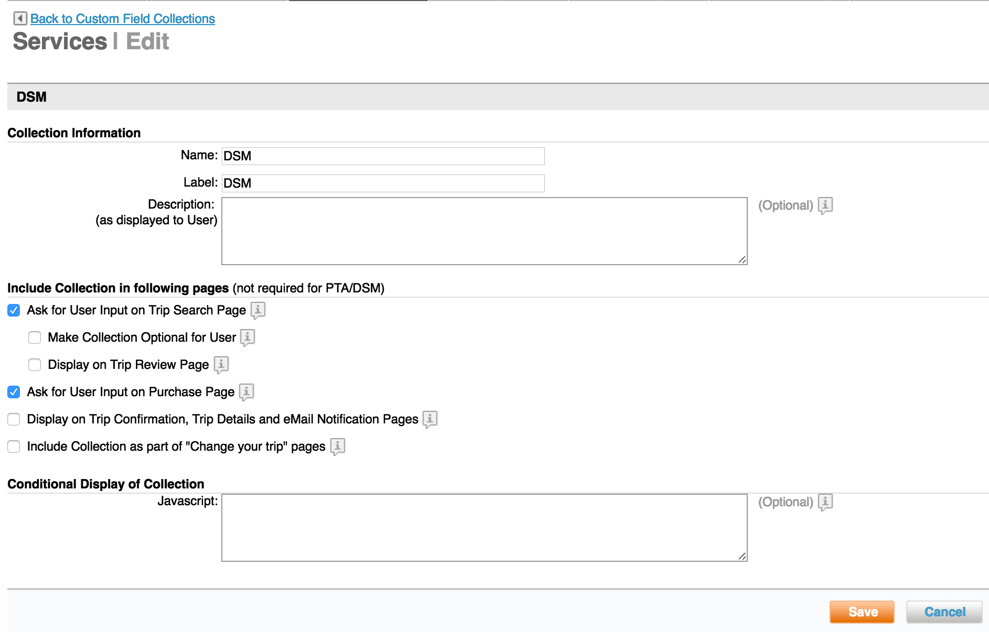
DSM Push Notifications
6 - Enter Collection Name
8 - Click Add a Custom Field
7 - Click Save

Slide 6
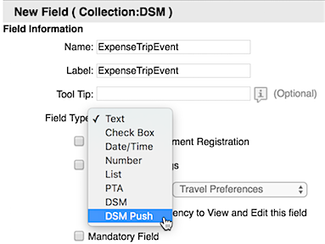
DSM Push Notifications
9 – Enter the name of the new custom field
10 – Click the dropdown arrow in the Field Type section and select DSM Push from the list

Slide 7
DSM Push Notifications
11 - Enter the message displayed to the user. (plain text or HTML tags)
12 - You can enter a date range during which the rule should be triggered
Notes:
Hyperlink (URL): This is an optional field and will be used in the case when notification needs to direct user to an external URL such as corporate policy or security

Slide 8
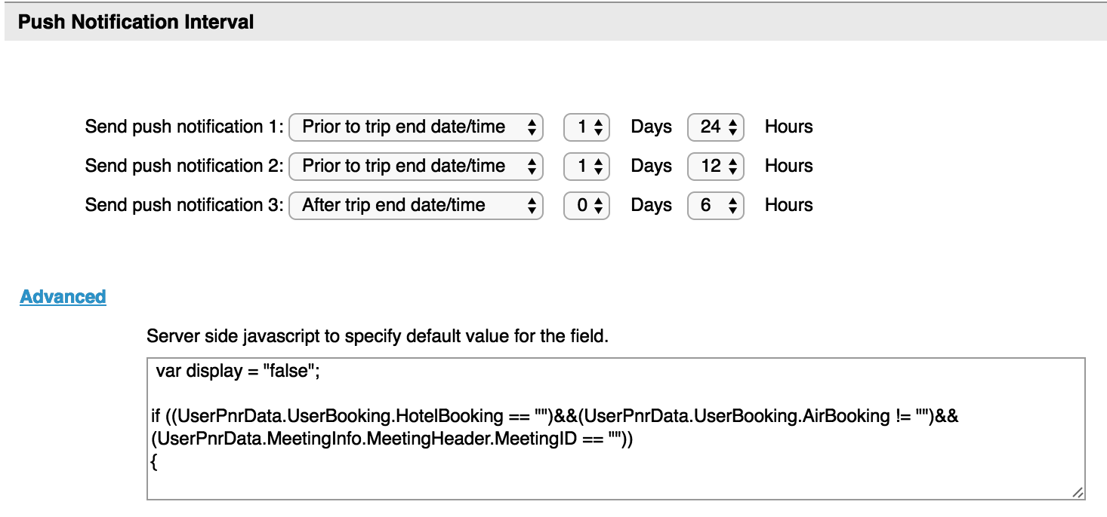
DSM Push Notifications
13 – Select the time intervals to send the push notifications:
Prior to trip start date/time Prior to trip end date/time After trip start date/time
After trip end date/time After trip creation date/time
14 - Click the Advanced link
to enter the JavaScript
criteria for this field
Notes:
Sequence the fields in the order of importance.
Add the collection to the set and the set to the group’s rule, if not already there.
Commit changes.

Slide 9
Pending Approval Tag Added to PTA Fields
A new PENDING APPROVAL tag has been added to our PTA fields this allows the site admins to add additional PNR remarks and place Pre-Trip reservations in queues based on their approval state (i.e. Pending approval).
With the addition of this new PENDING APPROVAL tag, we now offer more PNR Editor scripts to support agency back office processes.
Pre-Trip Approval PNR Editor fields now available:
Pending* (NEW)
Approved
Declined
Expired

Slide 10
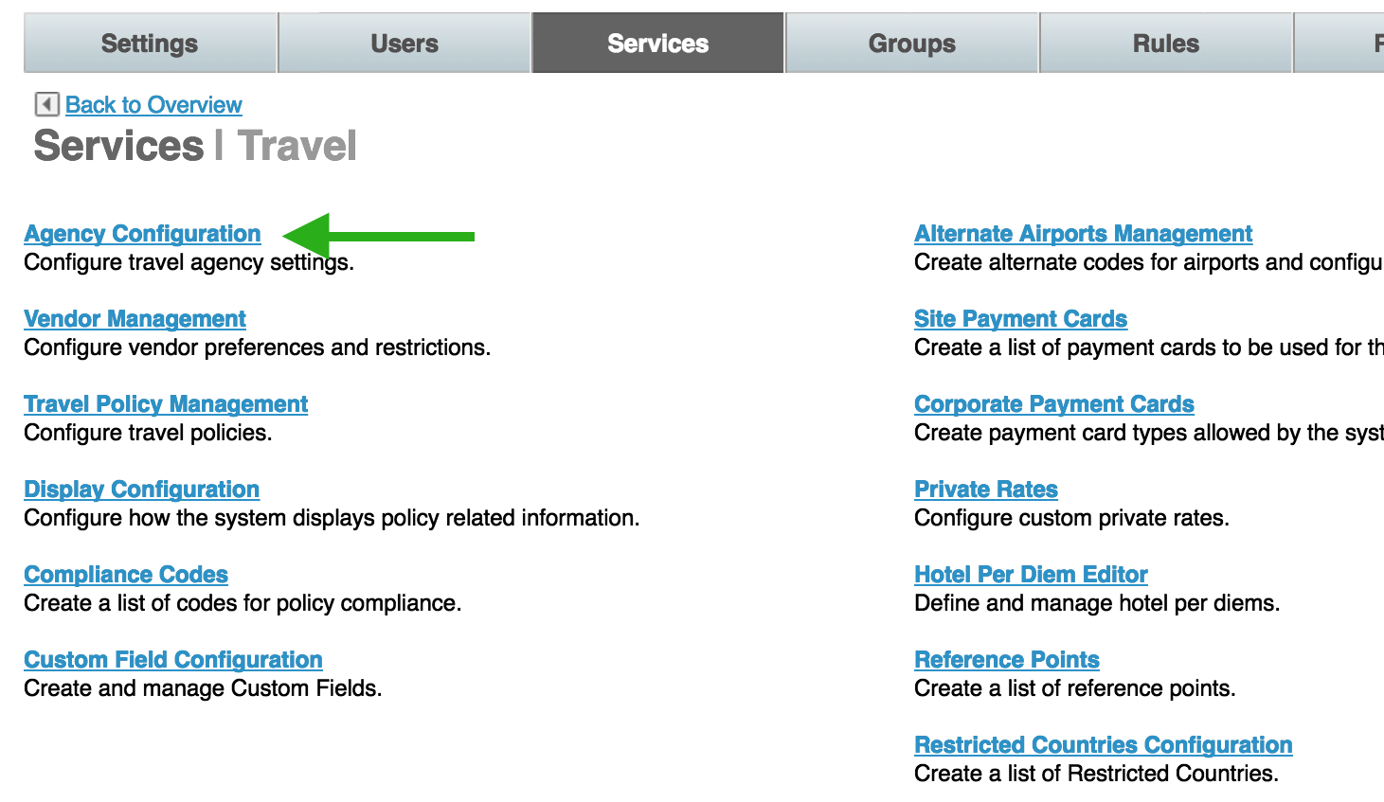
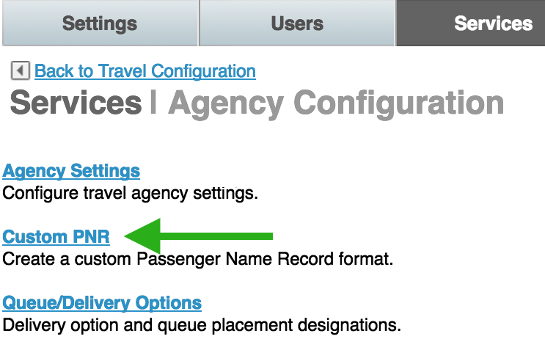
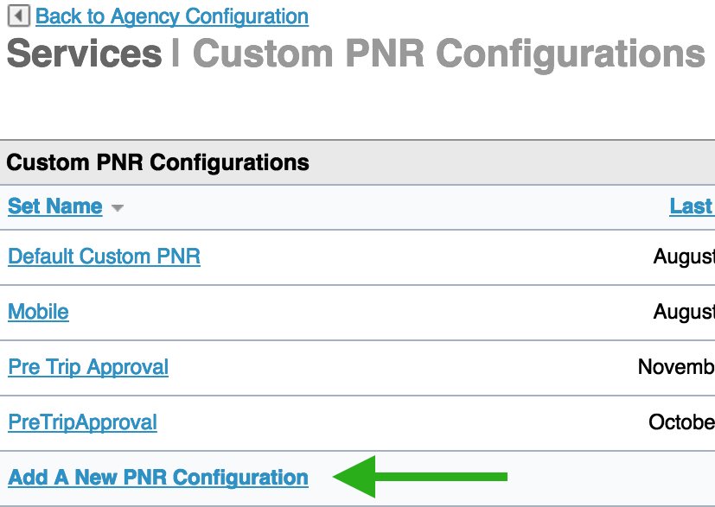
Pending Approval Tag Added to PTA Fields
Navigate to the Travel Services Page
Click Agency Configuration
Click Custom PNR
Click Add A New PNR Configuration

Slide 11
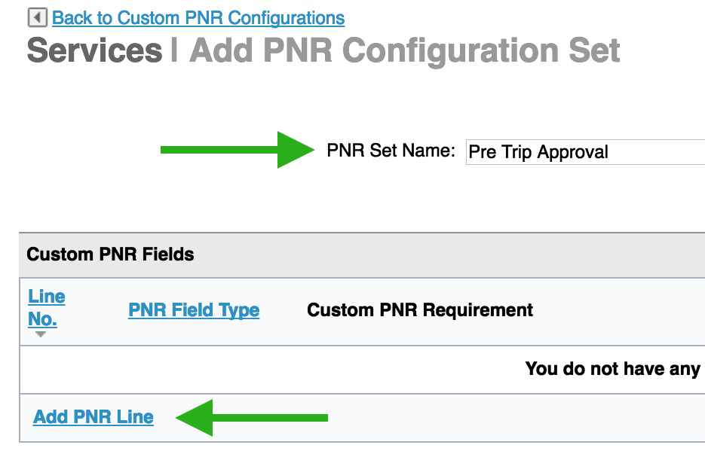
Pending Approval Tag Added to PTA Fields
The Add New PNR Configuration page displays
Enter the name of the set
Example Pre Trip Approval
Click Add PNR Line

Slide 12
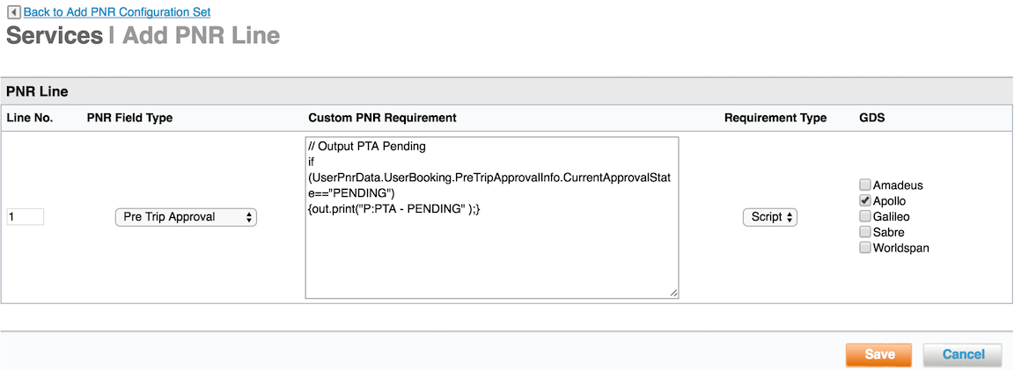
Pending Approval Tag Added to PTA Fields
Enter the line number in the line No. field
Select Pre Trip Approval from the dropdown menu.
Enter the appropriate script or text in the Custom PNR Requirement box
Select Script (JavaScript) or Text from the Requirement Type dropdown
Click one or more checkboxes for the GDS
Click Save

Slide 13
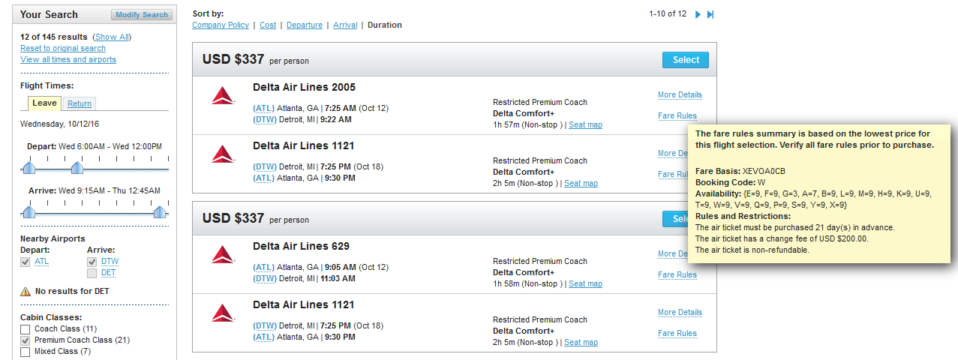
Delta Comfort + Fares and Seat Options
Delta has introduced a new Comfort+ booking option as part of their main cabin or premium economy class fares.
Travelers will now be able to search and select Delta Comfort+ fares and seat options on applicable Delta flights.

Slide 14
Delta Comfort + Fares and Seat Options
To ensure that Premium Economy is turned on for Delta in the dashboard, follow these steps:
From the Partner Dashboard, click the Service tab > Travel link > Travel Policy Management > Policy List
Select the policy name from the list and scroll down to the Premium Coach Class Policy section and click the YES radio button.
Click Save
Notes:
Limit premium coach class to international flights: Choose Yes or No.
Minimum flight time for premium coach class: Choose the hours and minutes of flight time before a premium coach class ticket would be allowed.
Apply minimum flight time per flight segment: Choose Yes or No. Yes is the usual choice. If you choose No, the minimum is applied to the total flight time for connecting flights.
Minimum flight distance for premium coach class: Enter the flight distance before a premium coach class ticket would be allowed, and choose the unit of distance measurement.

Slide 15
Delta Comfort + Fares and Seat Options
To display the Comfort + fares and seat options, follow these steps:
From the Partner Dashboard, click the Service tab > Travel link > Display Configuration > Display Configuration List
Select the Configuration Name
Scroll down to the Air Shopping Display Configuration for Premium Coach Cabin
Click the Name checkbox and the list for class of service will appear
Choose “Use default” or “Use custom”
Select Premium Coach airlines
Click on Delta Air Lines
Notes:
.
Choose "Use default" to use the default name ("Premium"), or "Use custom" and enter a custom name in the field.
Select Premium Coach airlines:
Click on Delta Air Lines
If others are selected, click and hold down Control (CTRL) in the selection box
Click Save
Add the collection to the set and the set to the group’s rule, if not already there.
Commit changes.

Slide 16
Added XML Tag in Pre/Post Booking Flow for Hotel Rate Changes
Messages are now displayed to notify
the users about hotel rate changes.
This provides additional information
and draws awareness to rate
changes for multi-day stay transactions
Choose DSM in the Field Type dropdown menu.
Enter the message to be displayed to the user. Plain text or HTML tags are allowed.

Slide 17
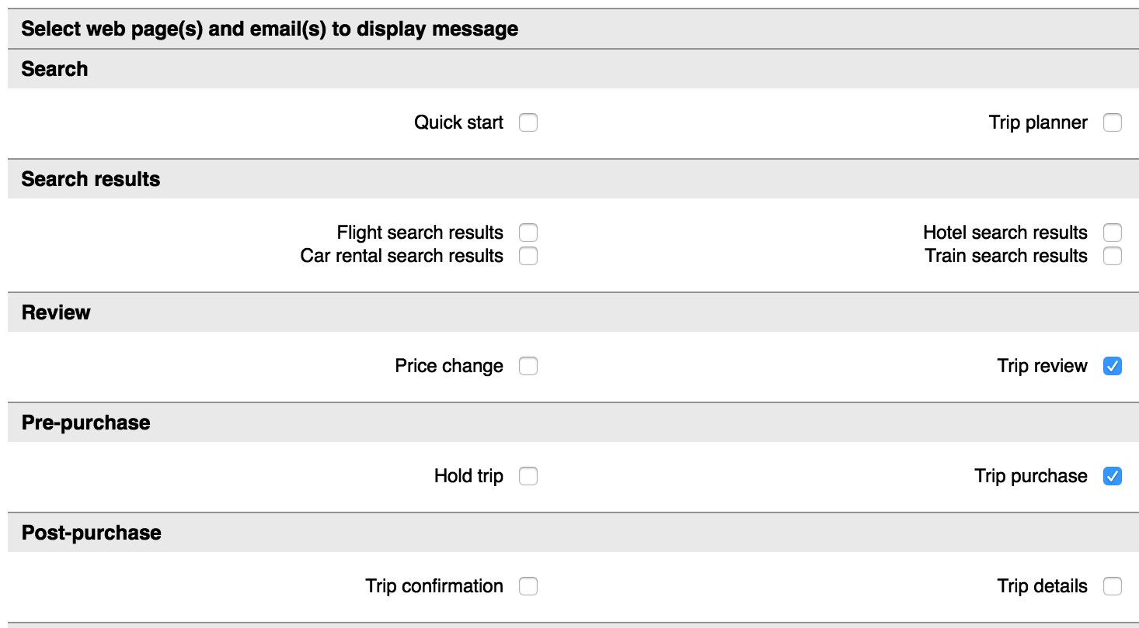
Added XML Tag in Pre/Post Booking Flow for Hotel Rate Changes
Define where the messaging will be displayed.
Select the checkbox beside any of these options:
Search pages:
Search result page:
Review pages:
Pre-purchase pages:
Post-purchase pages:
Hotel page:
Car rental pages: .
Cancellation pages: .
Emails:
Change Trip Flow pages:

Slide 18
Added XML Tag in Pre/Post Booking Flow for Hotel Rate Changes
Click the Advanced link at the bottom of the Notification Interval section to enter the JavaScript criteria for this field.
Click Save
Add the collection to the set and the set to the group’s rule, if not already there.
Commit changes.

Slide 19
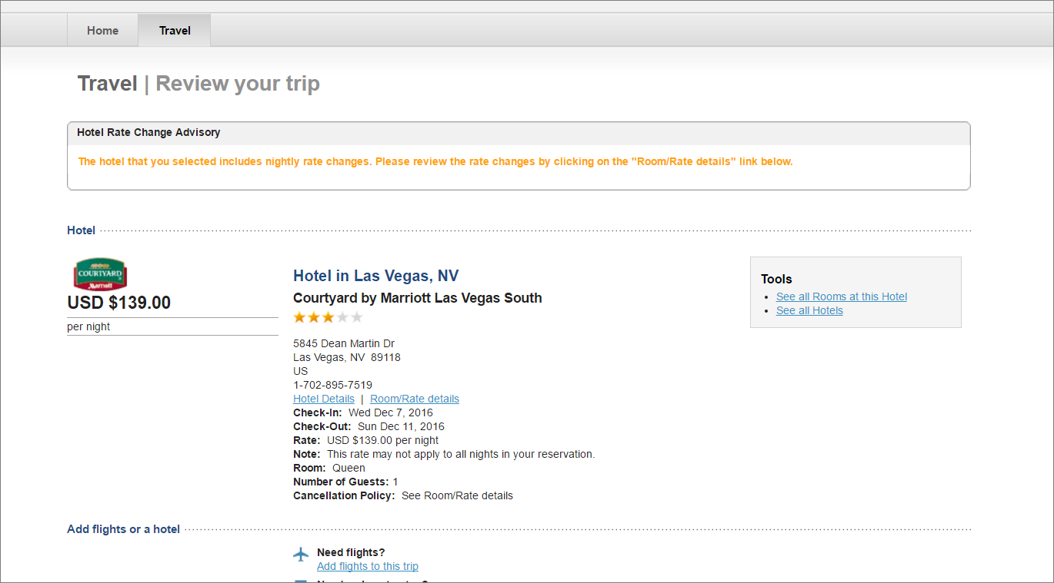
Added XML Tag in Pre/Post Booking Flow for Hotel Rate Changes
The travelers will then see the message displayed on the Review Your Trip page.

Slide 20
Dynamic Site Messaging (DSM) Now Displays Multiple Messages
This provides site administrators the option to display multiple DSM to end users.
Site Administrators can now define how many message display on a page, light box, mobile or email notification.
The system now displays all applicable message when overlapping rules apply. This configuration allows the site admin to define when only 1 message should display even in an overlapping rule scenarios.
The site admin has the ability to toggle
between the inline with other messages
to turn on and off the multiple messages
display.

Slide 21
Traveler Multiple Message View

Slide 22
Mobile Now Supports Travelfusion
Travel users now can book Travelfusion providers such as Ryan Air, Easy Jet, Interjet, etc.… on their mobile devices.
Users have more international flight options.
No configurations required.
Notes:
End User Experience: End users will now see and must accept the "Terms and Conditions" during the purchase flow.

Slide 23
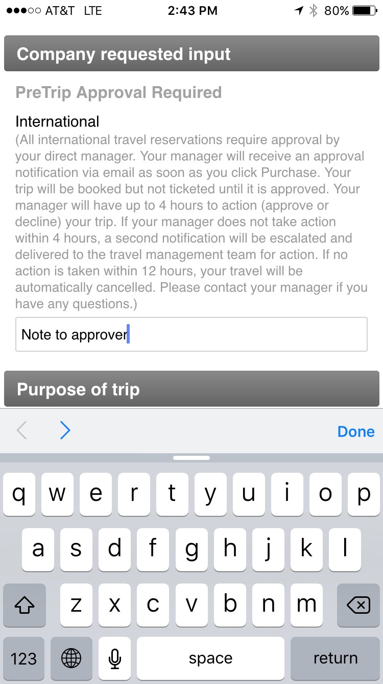
Mobile Pre-Trip Notification to Traveler
Deem has improved the mobile
pre-trip approval workflow to
include messaging on the purchase
page as well as the option for the
traveler to add a note to their approver.
User has more awareness when PTA is required
and the ability to message their approver while
booking on a mobile device.

Slide 24
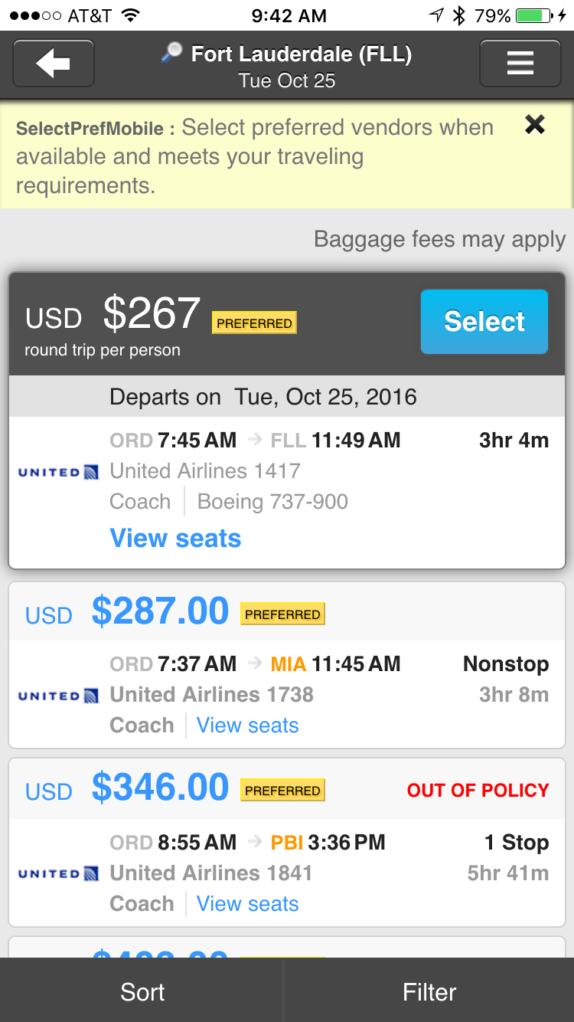
DSM Mobile Improvements
You've asked for it and we listened!
We have enhanced your ability to
message your travelers by increasing
the number of characters in a Dynamic
Site Message displayed on a mobile
devices from 150 to 250.
Configuration setup remains the same, you simply have an increased number of characters to work with.

Slide 25
Questions?

