Slide 1

All business. No trip.

Slide 2
Agenda
Review Q3 Releases
Review Major Categories
Questions

Slide 3
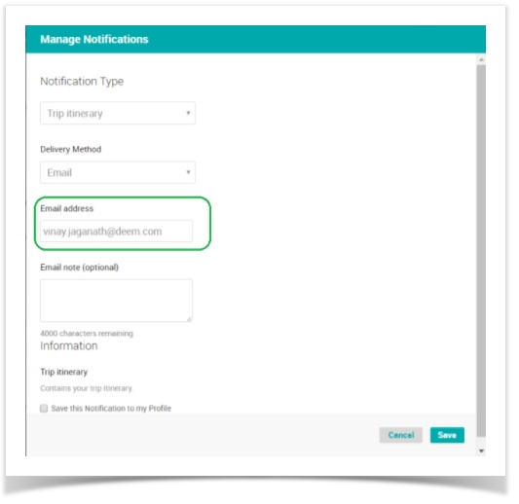
2017.2.5 Release
Notification Modal Adjustment
The Manage Notifications modal on the Purchase Page for the Trip Itinerary is now realigned into two columns for easy reading and better usability. In addition, some browsers' users were unable to add their email into the modal.
Site Admin Experience: No configuration required.

Slide 4
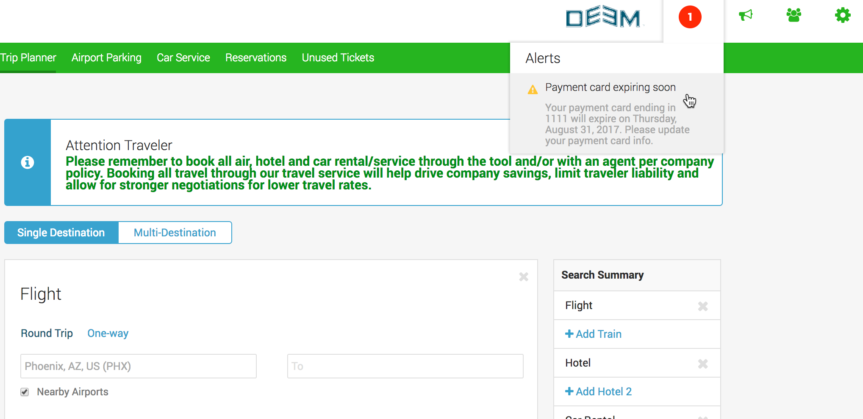
2017.2.5 Release
Alert Navigation Improvement
Now delegates and travelers can click the expired travel passport or visa warning alert which will take them to the profile where the user can update their information.
Site Admin Experience: No configuration required

Slide 5
2017.2.5 Release
MasterCard Bin Update
Deem Work Fource now supports the new MasterCard beginning with the number 2
Southwest Updates
Deem Work Fource is now able to recognize and display all Southwest Unrestricted
Premium Coach and fully refundable rates.
Three new Southwest Destination airports are now supported in Deem Work Fource:
  HAV, VRA, SNU - Cuba (begins Nov/Dec 2017)
  GCM - Grand Cayman
  MBJ - Montego Bay, Jamaica
  CVG – Cincinnati

Slide 6
2017.2.5 Release
Airport Parking Update
The following airport locations no longer offer Airport Parking Reservations.
Deem Work Fource is now updated to reflect these changes.
ORD - Chicago, Illinois
IND - Indianapolis, Indiana
MGM - Montgomery, Alabama
LGA - Laguardia Airport, New York
PBI - West Palm Beach, Florida
Site Admin Experience: No configuration required.

Slide 7
2017.2.4 Release
Defining Flight Search Results
Users can now select the "Refine Your Search" button and select "Non-stop" when completing a flight search. This enhancement will re-sort all of the flight results displaying all non-stop flight options first.

Slide 8
2017.2.4 Release
Flight Seat Map Usability Improvements
The Seat Request Advisory message now displays when a seat is not available as requested on the Trip Confirmation page.

Slide 9
2017.2.4 Release
Car Rental Usability Improvement
The car rental Pick-Up time now displays throughout the booking process. This ensures it is easily seen and if necessary, can be adjusted.

Slide 10
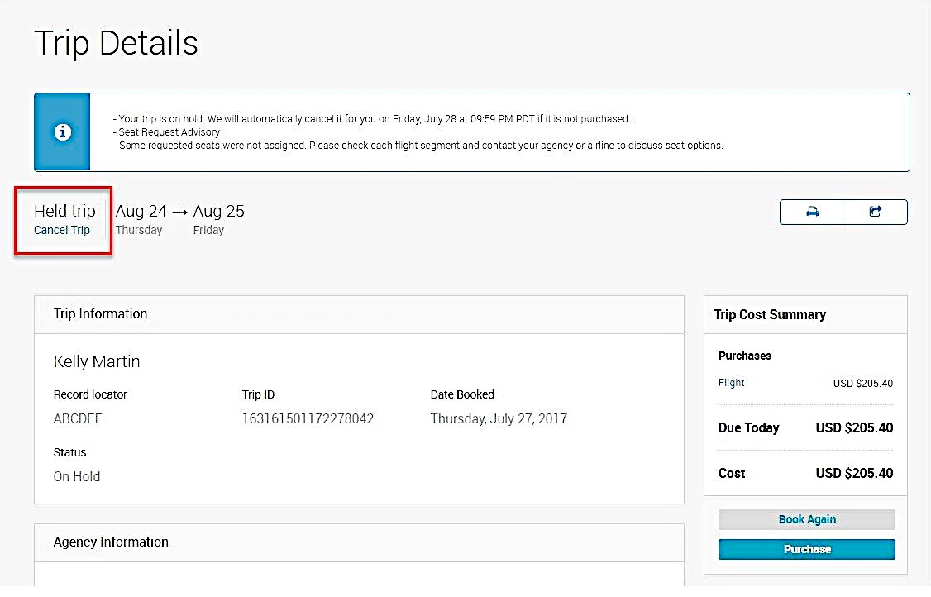
2017.2.4 Release
Canceling Held Trip
Users can now cancel a Held trip from the Trip Details page.

Slide 11
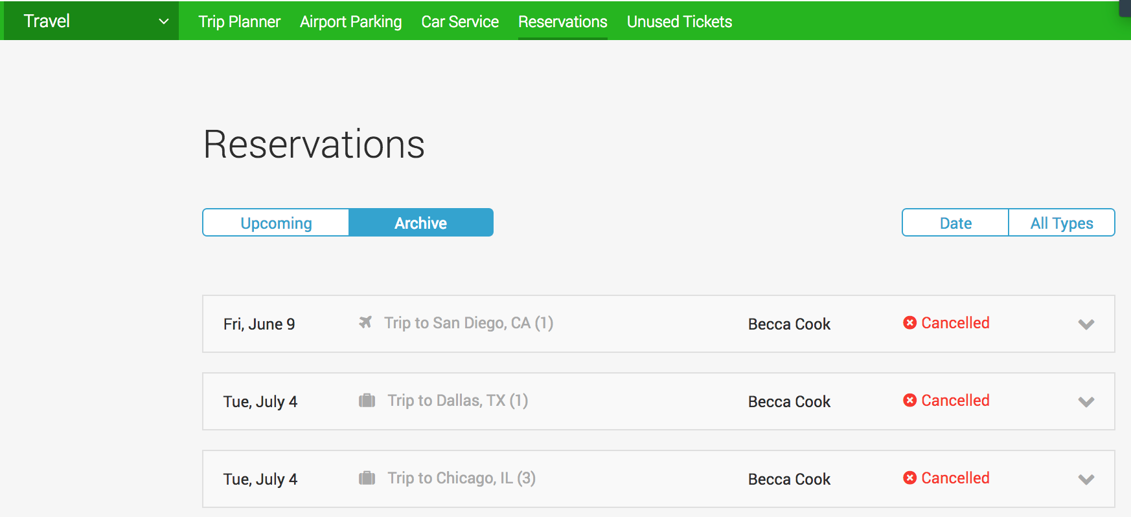
2017.2.4 Release
Canceling Held Trip
All cancelled trips including cancelled hotel only reservations will now display in the user's archived reservations.

Slide 12
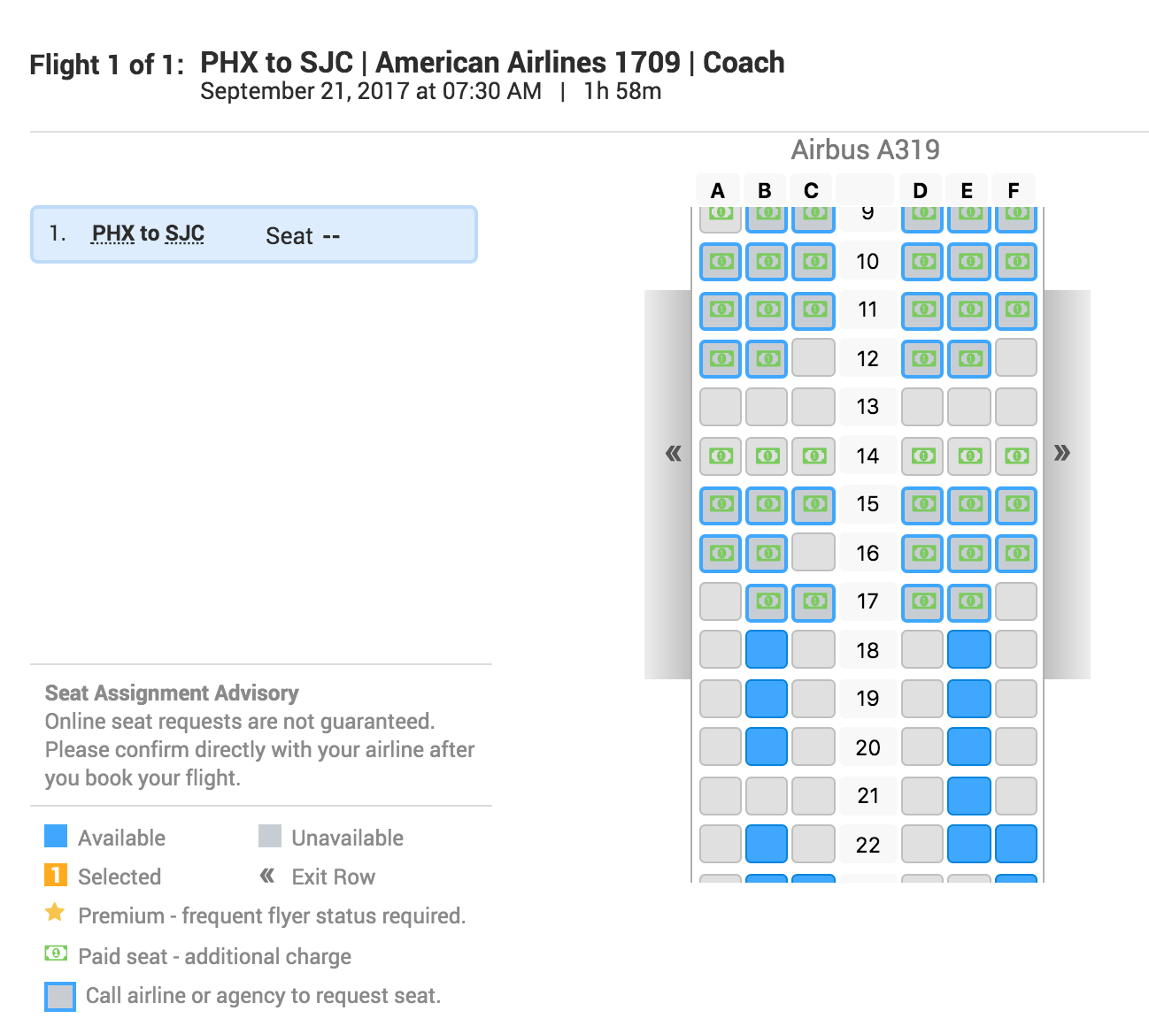


2017.2.3 Release
Flight Seat Map Enhancement
The Flight Seat Request Map has two new seat assignment icons.
Paid seat - additional charge (NEW)
- Note: Travelers are unable to pay for these seats at this time on Deem. This feature only highlights the seat inventory on the map that does require additional payment per the airline.
-Deem is working to launch seat payment options later this year.
Call airline/ agency to request seat (NEW)
This icon highlights those situations where seat is available, however the airline is directing the traveler to contact them directly or their travel agency to reserve the seat.

Slide 13
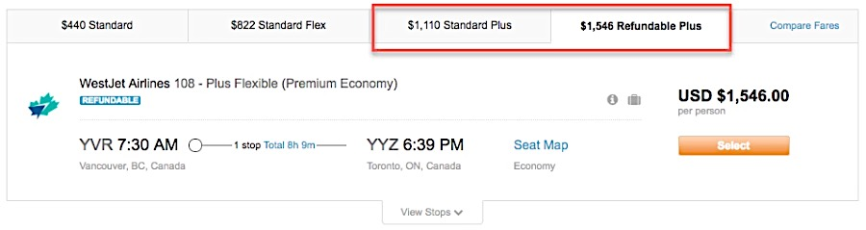
2017.2.3 Release
WestJet Plus Fares are Now Available for Travel
We have added the ability to book WestJet Plus fares.
Site Admin Experience: No configuration needed.

Slide 14
2017.2.3 Release
Avianca Brasil Now
Available for Travel
Avianca Brasil has been added to
the list of carriers supported on
Deem Work Fource.

Slide 15
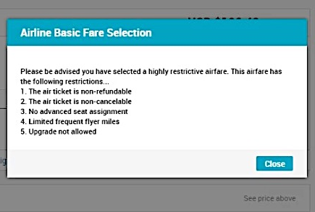
2017.2.2 Release
Dynamic Site Messaging (DSM) Now Supports Flexible Fares
  The new Travel Platform now supports DSM based on Flexible Fare selections in the booking flow process.
  For example: Site Admins can now configure DSM starting from the Trip Review page onward to ensure travelers have awareness and level of restriction based on selecting a basic fare. (Any Flexible Fares: Basic, Standard, Unrestricted, Refundable...)

Slide 16
June 15 Release
Car Rental Matrix Pricing Update
The car rental matrix now matches the car rental search result pricing.
Travelers will now see the base rate before taxes and fees in the matrix and search results.
Rates that include taxes and fees will display in the car search results below the base rate and when a traveler hovers over the matrix pricing.

Slide 17
2017.2.1 Release
Segment Service Status Icons added to the Trip Details Page
New status icons are now available on the Trip Details page. When a traveler hovers over the icon, the status of service displays such as "confirmed", "pending" and "cancelled".
This feature provides user awareness and visibility into each of the booked segments.

Slide 18
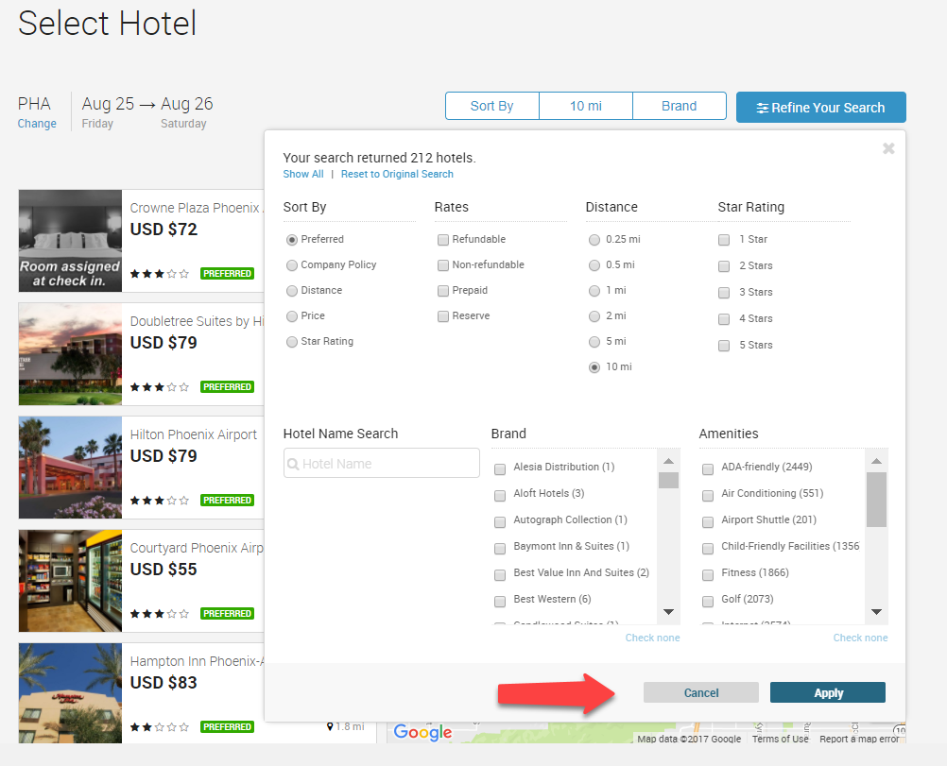
Hotel Search Results
What We Have Done
  Added Ability to Select Multiple Filters before Filter begins Search
  Limit Brands filter to only Brands returned in search
  Cosmetic Issues

Slide 19
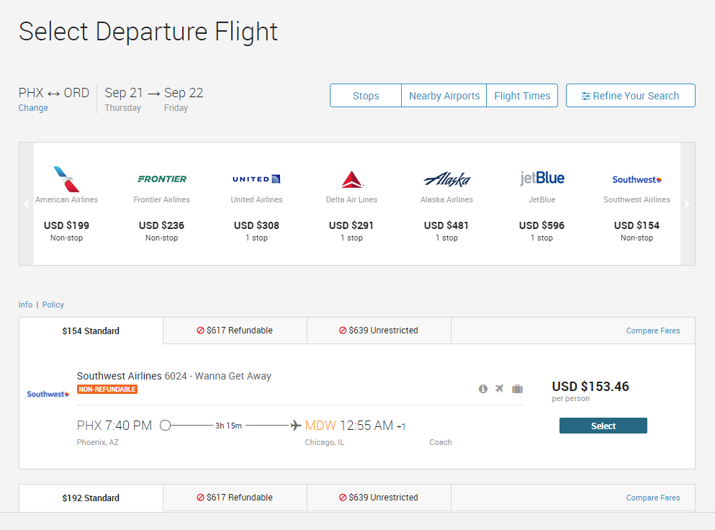
Flight Search Results
What We Have Done
  Schedule Search
  Enhanced Tool Tips
  Fare Tier Improvements
  Improved Alignment

Slide 20
Your Feedback
Thank you for your feedback and responses to our New UI
Every response has been reviewed, prioritized and slated for action
We want to show you an inside look to what we have done and are doing

Slide 21

Questions???

